Slide 1
Organizational Culture and Environment:
The Constraints
Chapter
3
© 2007 Prentice Hall, Inc.
All rights reserved.

Slide 2

Organizational Culture
  A system of shared meanings and common beliefs held by organizational members that determines, in a large degree, how they act towards each other.
    Values, symbols, rituals, myths, and practices
© 2007 Prentice Hall, Inc. All rights reserved.
3–<number>

Slide 3
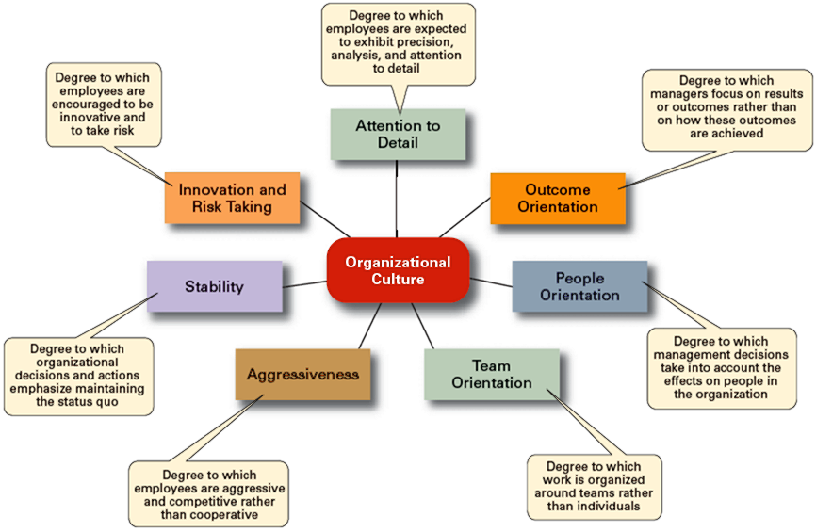
Exhibit 3–2 Dimensions of Organizational Culture
© 2007 Prentice Hall, Inc. All rights reserved.
3–<number>

Slide 4
Exhibit 3–3 Contrasting Organizational Cultures
Dimension | Organization A | Organization B
Attention to Detail | High | Low
Outcome Orientation | Low | High
People Orientation | Low | High
Team Orientation | Low | High
Aggressiveness | Low | High
Stability | High | Low
Innovation and Risk Taking | Low | High
© 2007 Prentice Hall, Inc. All rights reserved.
3–<number>

Slide 5
Strong versus Weak Cultures
Strong Cultures
  Are cultures in which key values are deeply held and widely held.
  Have a strong influence on organizational members.
Factors Influencing the Strength of Culture
  Size of the organization
  Age of the organization
  Rate of employee turnover
  Strength of the original culture
  Clarity of cultural values and beliefs
© 2007 Prentice Hall, Inc. All rights reserved.
3–<number>

Slide 6

Benefits of a Strong Culture
Creates a stronger employee commitment to the organization.
Aids in the recruitment and socialization of new employees.
Fosters higher organizational
performance by instilling and
promoting employee initiative.
© 2007 Prentice Hall, Inc. All rights reserved.
3–<number>

Slide 7
Organizational Culture
Sources of Organizational Culture
  Leadership
  Past practices of the organization
Continuation of the Organizational Culture
  Recruitment of like-minded employees who “fit”
  Socialization of new employees to help them adapt to the culture
© 2007 Prentice Hall, Inc. All rights reserved.
3–<number>

Slide 8
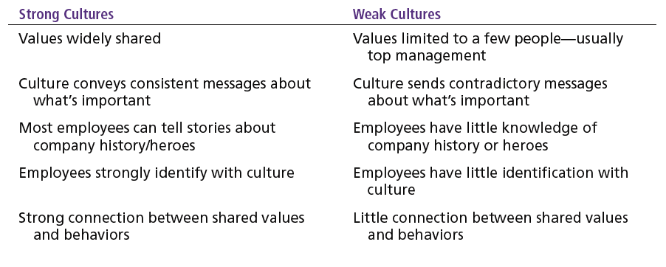
Exhibit 3–4 Strong versus Weak Organizational Cultures
© 2007 Prentice Hall, Inc. All rights reserved.
3–<number>

Slide 9
How Employees Learn Culture
Stories
  Narratives of significant events or actions of people that convey the spirit of the organization
Rituals
  Repetitive sequences of activities that express and reinforce the values of the organization
Material Symbols
  Physical assets distinguishing the organization
Language
  Acronyms and jargon of terms, phrases, and word meanings specific to an organization
© 2007 Prentice Hall, Inc. All rights reserved.
3–<number>

Slide 10
Organization Culture Issues
Creating an Ethical Culture
Creating an Innovative Culture
Creating a Customer-Responsive Culture
© 2007 Prentice Hall, Inc. All rights reserved.
3–<number>

Slide 11

© 2007 Prentice Hall, Inc. All rights reserved.
3–<number>

Slide 12
Workplace Spirituality
  The recognition that people have an inner life that nourishes and is nourished by meaningful work that takes place in the context of community.
Characteristics of a Spiritual Organization
  Strong sense of purpose
  Focus on individual development
  Trust and openness
  Employee empowerment
  Toleration of employees’ expression
© 2007 Prentice Hall, Inc. All rights reserved.
3–<number>

Slide 13
External Environment
Components of the External Environment
  Specific environment:
    external forces that have a direct and immediate impact on the organization.
  General environment:
    broad economic, socio-cultural, political/legal, demographic, technological, and global conditions that may affect the organization.
    PEST (Video: PEST Analysis)
© 2007 Prentice Hall, Inc. All rights reserved.
3–<number>

Slide 14
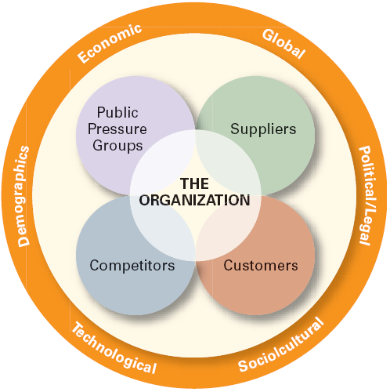
Exhibit 3–9 The External Environment
© 2007 Prentice Hall, Inc. All rights reserved.
3–<number>

Slide 15
Who are Stakeholders
Shareholders V/s Stake holders (Video)
© 2007 Prentice Hall, Inc. All rights reserved.
3–<number>

Slide 16
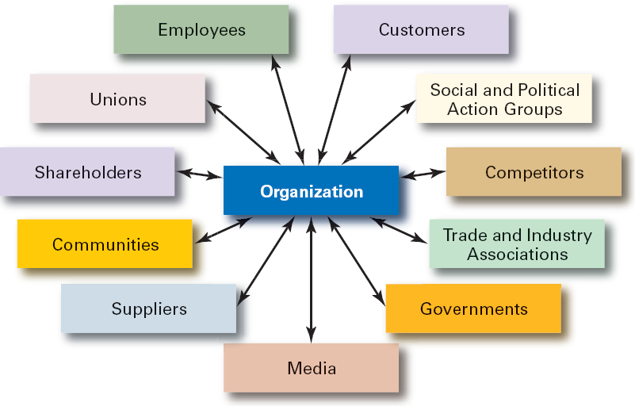
Exhibit 3–12 Organizational Stakeholders
© 2007 Prentice Hall, Inc. All rights reserved.
3–<number>

